Slide 1
Predict Car Accident Severity
IBM Data Science Capstone Project

Slide 2
Problem definition and Target Audience
As the number of vehicles and transportation means are varying and increasing the number of road accidents are increased too, this project aimed to use the data science and ML methodologies and algorithms to study the historical circumstances recorded during car accident.
The improved model will participate in the effort to reduce the severity of car collisions in a community through alerting drivers and roads riders by police, media and local institutions to be more careful in certain bad circumstances (weather, road and visibility conditions).

Slide 3
Source of Data
A historical data for all types of collisions from (2004) until present recorded by “SDOT Traffic Management Division, Traffic Records Group” and provided by Coursera will be used to train and test the developed model.

Slide 4
The model variables Selected
The target feature Severity is binary
1 :Damage .
2 :Injury.
Independent variables are
A description of the weather conditions during the time of the collision.
The condition of the road during the collision.
The light conditions during the collision.

Slide 5
Classification Models
The following processes performed on the dataset:
Dropping unneeded columns.
Decode data
Balance data
Splitting data for training (80%) and testing (20%).

Slide 6
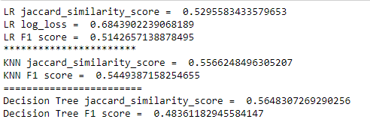
Results
The table below report the evaluation on test data

Slide 7
Conclusion and Future work
Predict severity of car accident by models help to reduce it.
Accuracy of the models need improvements.
Additional attributes may help to improve the prediction model.

